Slide 1
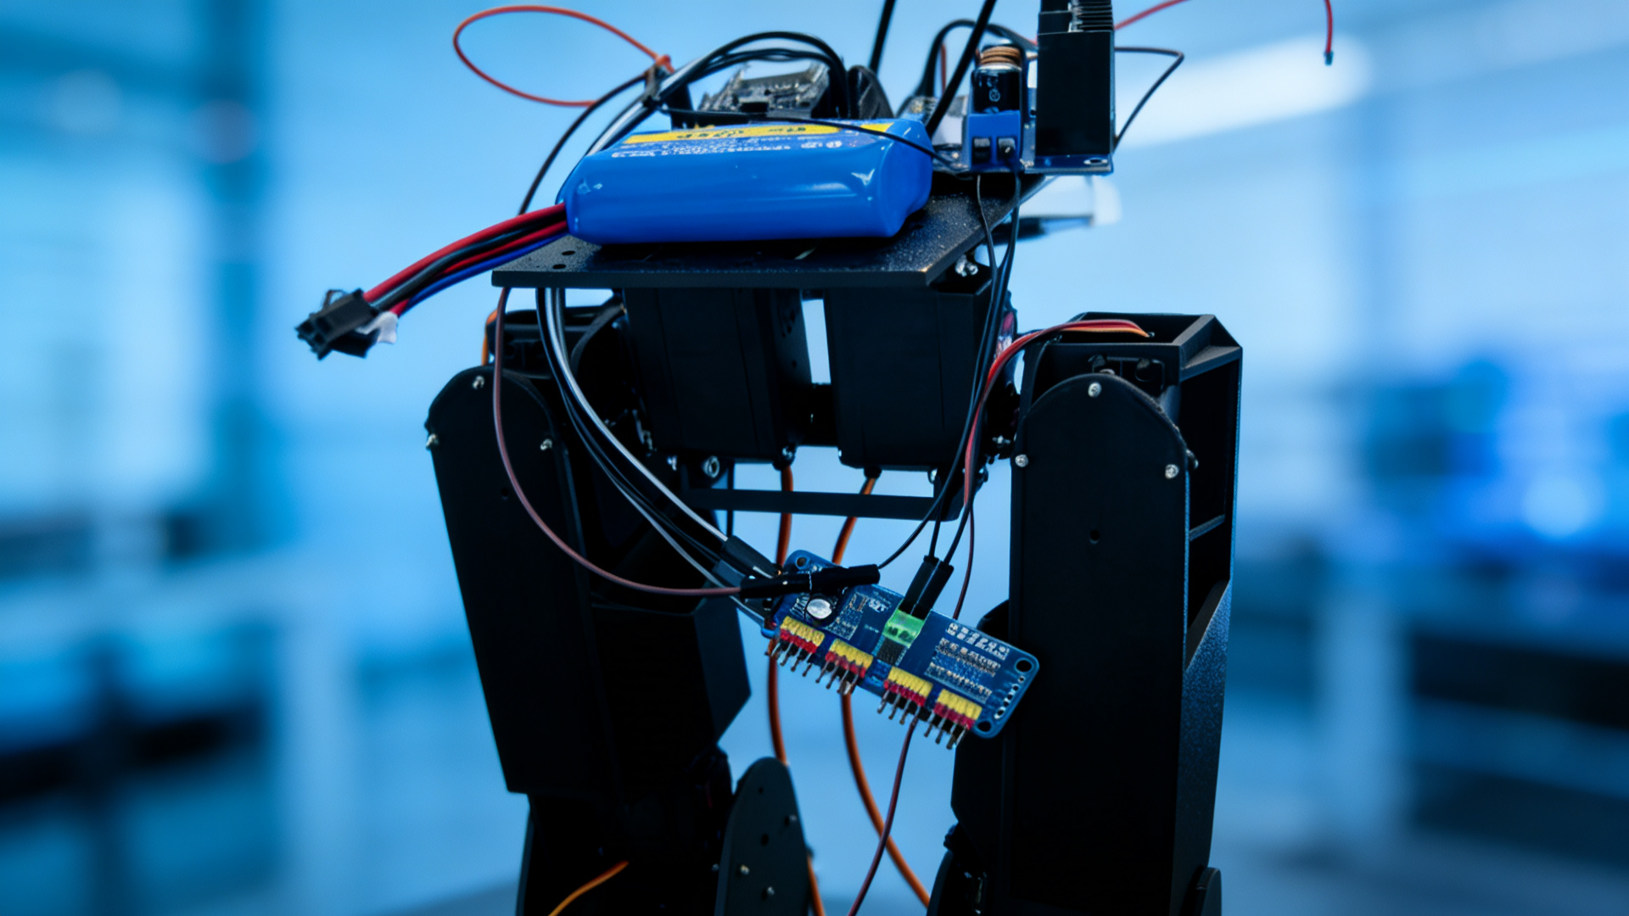
Bipedal Robot Project Progress Report
Team: Group 1
INTELLIGENT ROBOTICS LAB
Notes:
Hello everyone, welcome to the progress report of our Biped Robot project. I am the representative of Group 1, and today I will present our latest progress, design updates, challenges encountered, and the next steps for the project.

Slide 2

Agenda
01
Project Overview
02
Current Progress
03
Design Update
04
Problem Analysis
05
Solutions & Next Steps
Notes:
This presentation will be divided into five parts: first, the project overview; second, our current progress; third, the recent design updates; fourth, problem analysis; and finally, our solutions and next steps.

Slide 3
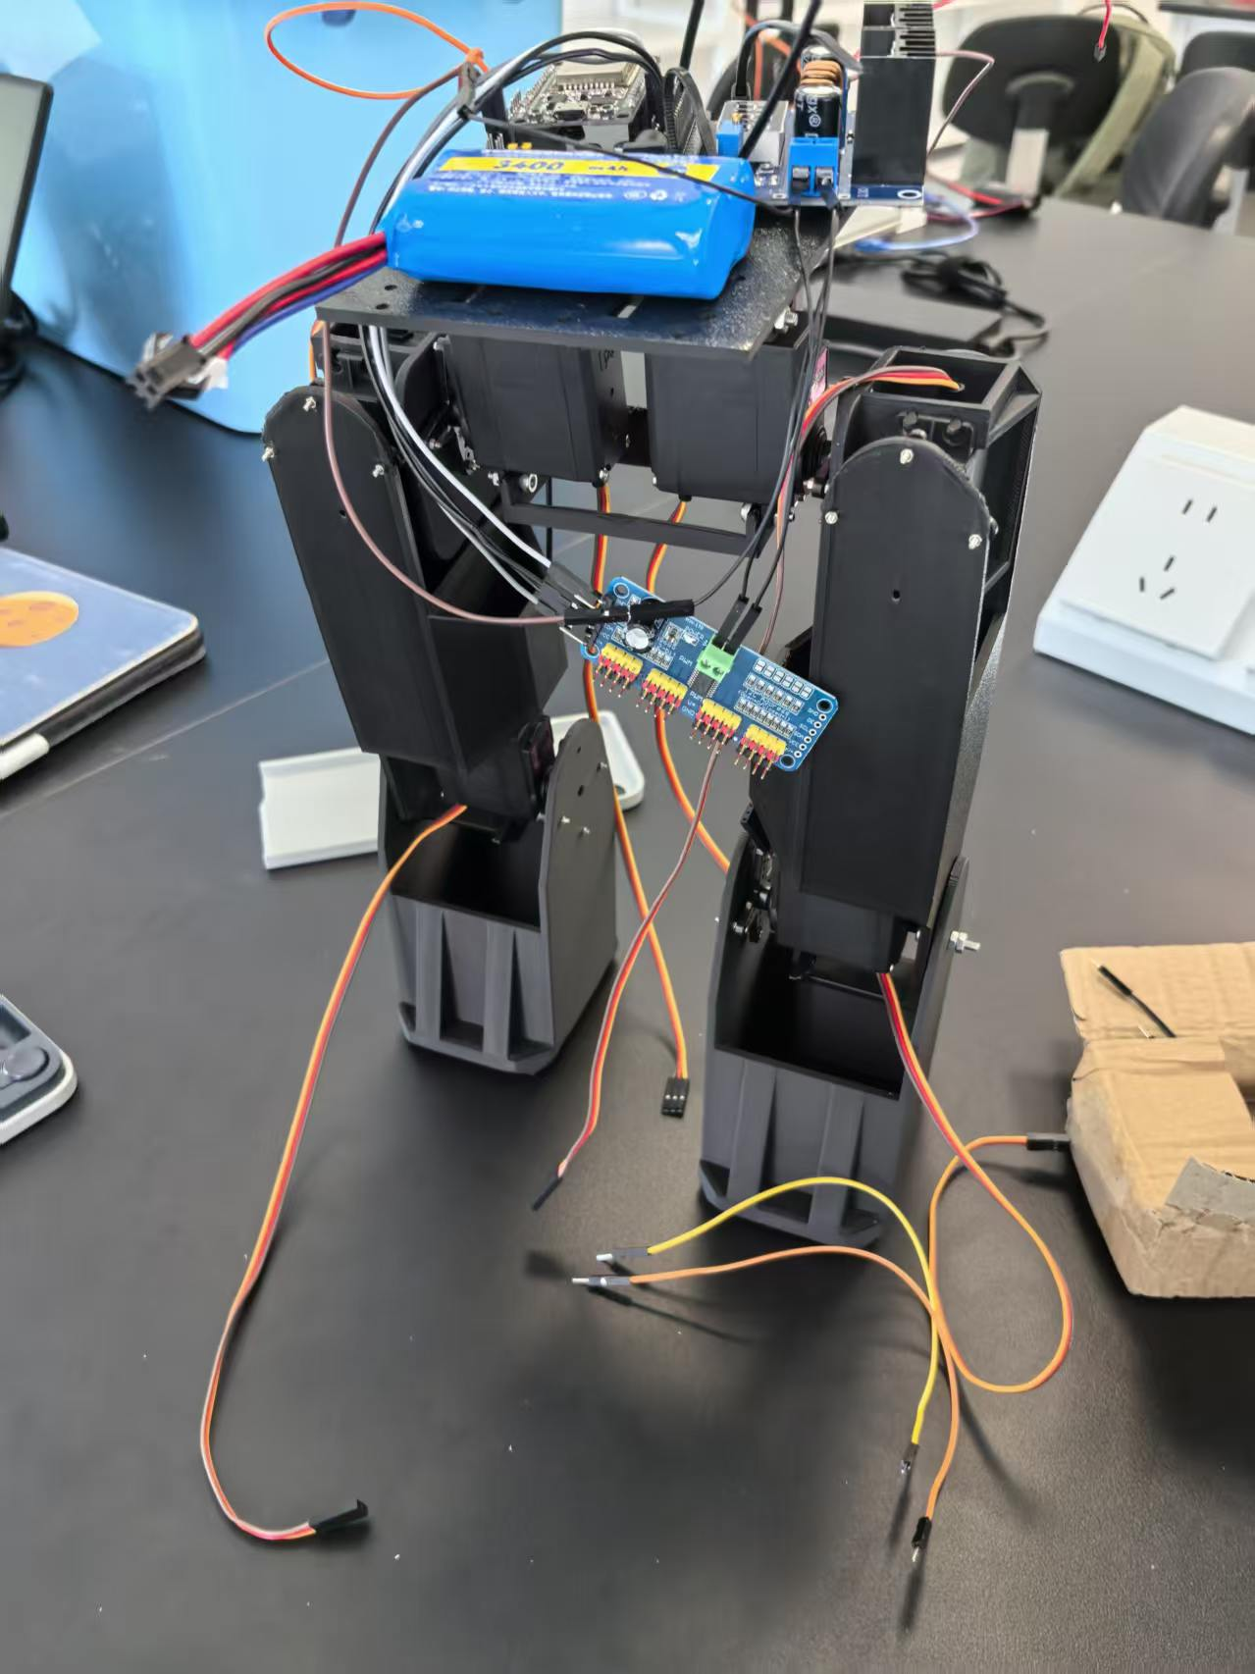
Project Overview
The goal of this project is to develop a bipedal robot capable of stable walking and autonomous control. By integrating mechanical structure, electronic control systems, and visual recognition modules, we aim to create a practical robot prototype.
Mechanical
Electronic
Vision
Integrating Mechanics, Electronics, and Software for Next-Gen Robotics
Notes:
The core goal of our project is to develop a biped robot that can walk stably like a human and possess a certain degree of autonomous control. This requires in-depth research and integration in mechanical design, electronic control, and software algorithms.

Slide 4
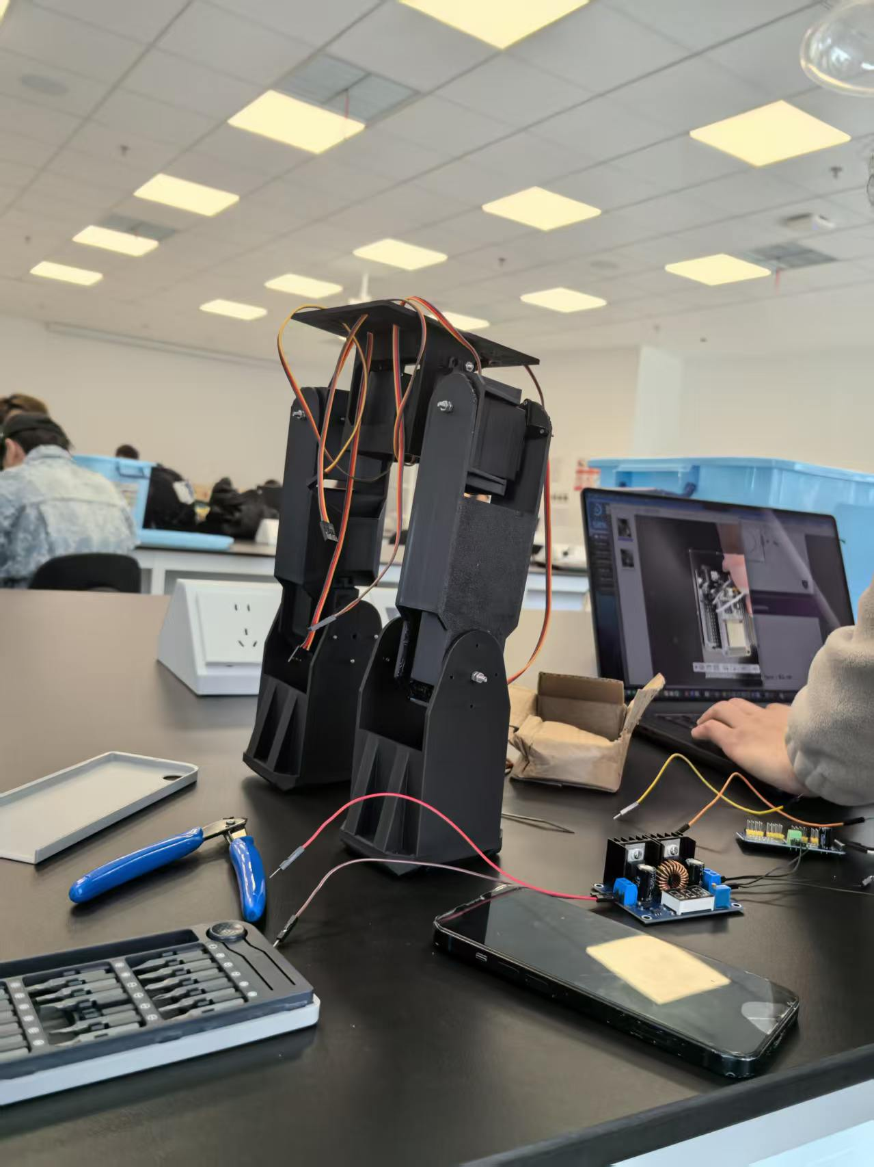
Current Progress - Hardware Assembly
We have successfully completed the overall mechanical assembly of the robot, including the legs, torso, and head.
The robot structure is now fully assembled and ready for further testing.
Basically
Assembled
Robot
Status: Mechanical Structure Complete | Next Step: System Integration & Testing
Notes:
Regarding our current progress, we have successfully completed the mechanical assembly of the robot. As you can see from the picture, the entire structure, including the legs, torso, and head, is fully assembled and ready for the next phase of testing.

Slide 5
Current Progress - Servo Driving
We have successfully established communication and driven all the servos. Basic movement commands are being executed as expected.
Servos reset immediately after rotation. They perform the action but fail to maintain the target angle, reverting to initial positions.
Next Step:Investigate power supply stability and motor driver configuration to resolve the position holding failure.
Notes:
We have also successfully connected and driven all the servos. However, we encountered a critical issue during testing: when we send a command for the servo to rotate to a certain angle, it immediately returns to the initial position after completing the action, which prevents the robot from maintaining a stable posture.

Slide 6
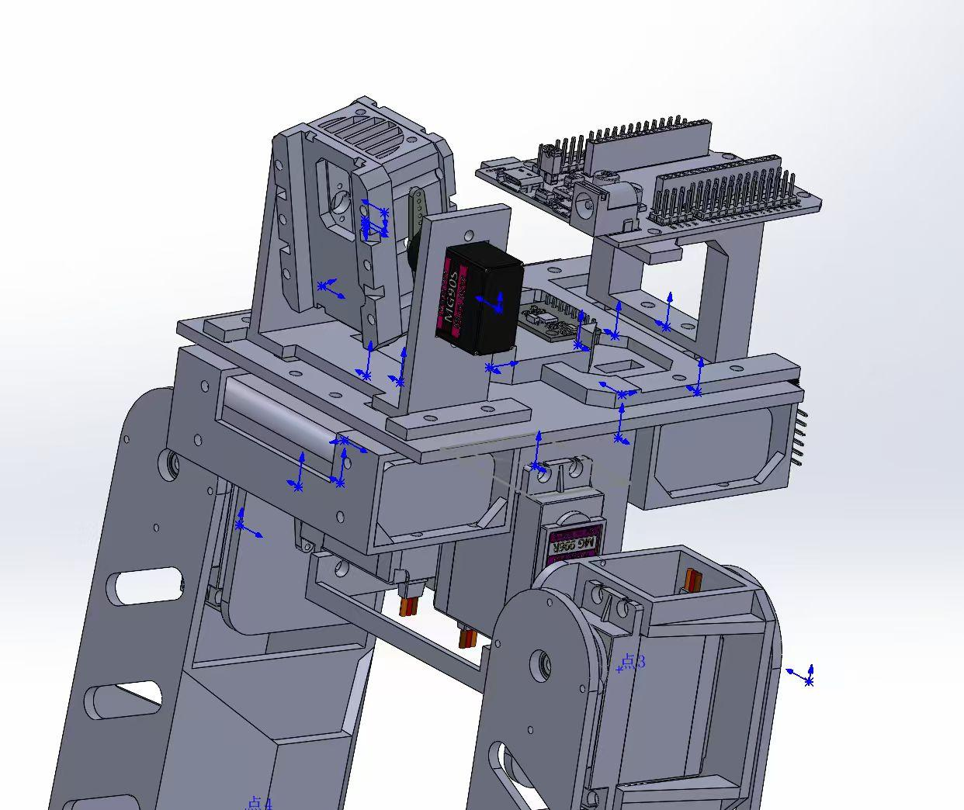
Design Update - Upper Body Remodeling
The robot's upper body has been fully remodeled with optimized structural design, focusing on enhancing integration efficiency and physical balance.
Dedicated ESP32 Mounting- Optimized position for the main control board ensuring secure connections.
Camera Integration- Fixed bracket for precise visual perception alignment.
Battery Compartment- Reinforced design improves weight distribution and balance.
Engineering Design Phase | v2.0
Notes:
In terms of design updates, we have remodeled the upper body of the robot. The new design, as shown in the CAD model, includes dedicated and optimized mounting positions for the ESP32 board, camera, and battery. This will not only improve the robot's balance but also make the integration of electronic components more efficient.

Slide 7
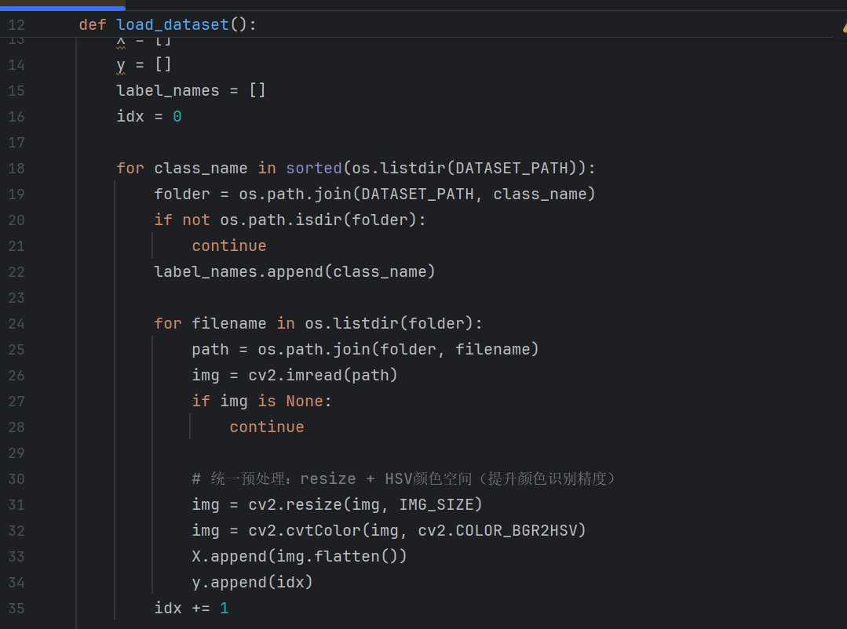

Slide 8
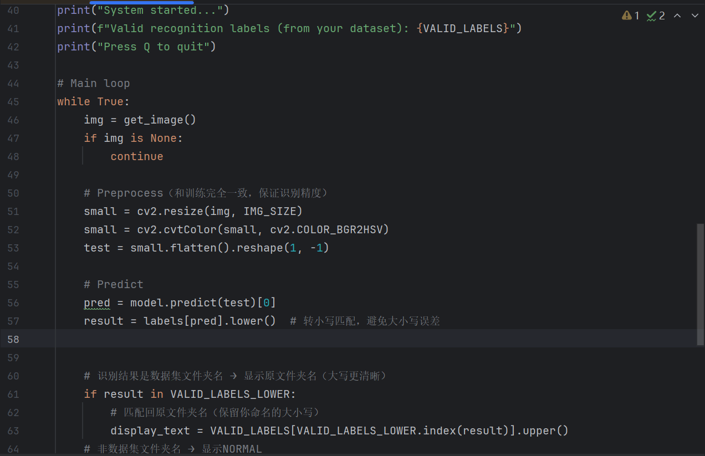

Slide 9

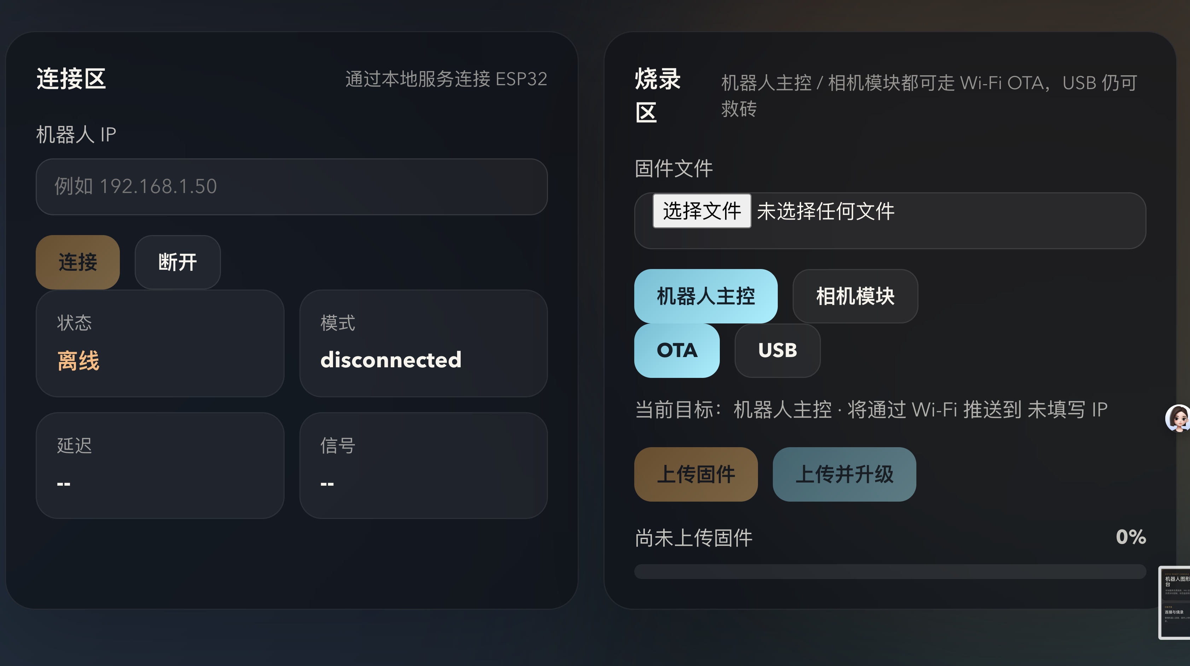

Slide 10
Servo Reset Analysis
Core Problem
Servos reset to initial position after executing a command, failing to maintain the target angle.
Software Logic
Logical errors in the control code leading to unexpected resets.
Hardware Connection
Potential loose wiring or faulty connections causing signal loss.
Power Supply
Unstable voltage causing insufficient torque to hold position.
Notes:
We are currently analyzing the servo reset issue. The core problem is that the servos cannot maintain their target angle after moving.
We suspect the causes might be related to logical errors in the control code, potential hardware connection issues, or an unstable power supply that fails to provide sufficient torque for the servos to hold position.

Slide 11
Solutions & Next Steps
Solutions
Next Steps
Debug the control code to ensure angle maintenance.
Inspect and secure all hardware connections.
Test and optimize the power supply.
Complete the troubleshooting of the servo reset issue this week.
Print and assemble the newly designed upper body parts.
Conduct walking tests after assembly.
Focus on resolving current issues and advancing to physical testing phase.
Notes:
To address the servo reset problem, we plan to debug the control code, inspect all hardware connections, and optimize the power supply this week. Additionally, the newly designed upper body parts are currently being printed and will be assembled this week. After assembly, we will conduct walking tests to verify the robot's functionality.

Slide 12
Thank you
Q&A
Notes:
To address the servo reset problem, we plan to debug the control code, inspect all hardware connections, and optimize the power supply this week. Additionally, the newly designed upper body parts are currently being printed and will be assembled this week. After assembly, we will conduct walking tests to verify the robot's functionality.

